Slide 1
Kuipp – Product layout & Design
Design & Functionality

Slide 2
Lineage Tree
Lineage Tree
First page user sees when he opens the application for the first time
Kuipp
Welcome to Kuipp! Ask some questions, find some answers…quick
Register
Login
© 2010 Kuipp
[Ad Space]

Slide 3
Directory
Directory Layout
6 distinct categories for user navigation
Each category has a distinct logo (to design)
To decide – whether MyKuipps, Recent Kuipps and Kuipp it should be categorized as sub-categories within one tab (currently subcategorized)
Note: Changed from having 9 category layout to simplified version as MyKuipps can be consolidated with subcategories. Inefficient to have user click back to main directory too many times
Profile
Friends
Map
MyKuipps
Messages
Settings
[Ad Space]

Slide 4
Profile
Profile
Basic user profile overview
To discuss what statistics to show for user stats
Black arrows link to separate page with additional detail
Follow: allows user to add John to follower’s list
Send Msg: send direct message to user. Pop-up box allowing user to send message directly to John [Push optionality]
Friends: link to Friends tab
Lineage: Visual overview of adviser hierarchy. Can also link to Lineage tab by clicking on “# of [Disciples]” ← think of name for this
John Doe
[Insert Rank Picture]
Cadet Level: 3
12 Badges
$100 Kuippys
[Pic]
[Pic]
John’s Stats - Asked Kuipps: 35 - Answered Kuipps: 38 - Points to next level: 105
- # of Popped Questions: 20 - # of [Disciples]: 3
[Update with users most recently asked ?]
[Update with users most recently answered ?]
Follow
Send Msg
Friends
Lineage
[Ad Space]

Slide 5
Message
Message
Allows user to respond to direct messages that followers send to each other. Messages can only be sent to users that are already followers of each other [discuss – is necessary to limit this?]
When the user clicks to view a message, he is brought to a separate page where the message is listed along with a reply box
Search Messages
Ninja
[Message]
Jane Doe
Ninja
[Message]
Jane Doe
Ninja
[Message]
Jane Doe
Ninja
[Message]
Jane Doe
[Ad Space]

Slide 6
Friends
Friends
: Allows user to navigate back to Directory tab
: Allows user to refresh page [to discuss when page warrants having a refresh button]
Technical question of complexity of integrating search
“Add Friends” function allows user to add friends from facebook/gmail/etc, otherwise sends a invite to them
Viral – When user adds data via Facebook connect, Friends list should automatically populate with Friends that already use the application
Search Friends
+ Add Friends
Jane Doe
Jane Doe
Jane Doe
[Ad Space]

Slide 7
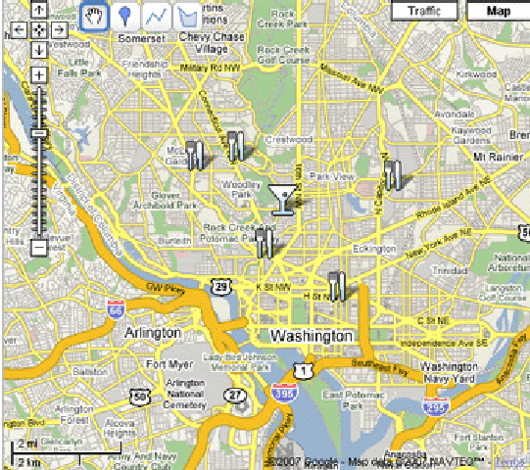


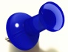

Map
Map
Google Maps integrated function that allows users to scan visually through geo-tagged questions
Realtime feature – Pushpins will update on map with the most recent ones appearing
Questions appear as pinpoints, with the entire question popping up when the user pushes on the pin
Search function allows user to search for recent Kuipps in San Francisco
Clicking on question pin will direct user to the specific user’s Q&A responses thus far
Time function: For questions that have not been answered, or “popped” yet, the time remaining appears in red on the question box to further entice users to answer the question
John Asked -Where are the latest sales at Macy’s?
3 mins
Chris asked - Where can I find the best sushi in SOMA?
Pete asked - Why is this CPK Pizza closed for the weekend?
35 secs
4 mins
Kuipppers
Followers
Me
[Ad Space]

Slide 8





MY Kuipps
MY Kuipps
My Kuipps – allows user to see his/her recent Kuipps shown for both asked and answered questions, recent Kuipps, and Kuipp It function
Asked – shows the questions in chronological order that the user has asked
Answered – shows the question in chronological order that the user has answered
Following – Trending Kuipps that user has decided to follow
Recent– shows all the recent Kuipps in the area, ranked by length of time since asked and whether the question has been responded to yet
KuippIt! – allows user to ask a question
Arrows link to question and answer trend showing a twitter-like chain (see next page)
Discuss how to best organize statistical data of responses/time/gold/likes/dislikes
All answers should fit within the same height. Longer responses will be condensed and the user will have to click on “…more” in order to expand the question to view the complete message
Similar setup will apply for the “Answered/Following/Recent category, which will link to a similarly formatted tab that shows the main question being asked. User can then click to expand to the entire question trend (see Question & Answer Layout slide)
Asked
Answered
Following
Recent
KuippIt!
[Sort by category, amt of gold, and loc]
[Search]
Ninja
What are the latest sales at Macy?
[Location]
5
10m
100
2
3
Jane Doe
Ninja
What are the latest sales at Macy?
…more
[Location]
5
10m
100
2
3
Jane Doe
Ninja
What are the latest sales at Macy?
…more
[Location]
5
10m
100
2
3
Jane Doe
[Ad Space]

Slide 9

Question and Answer Layout
Question and Answer Layout
Questions and answer layout for all Kuipps
Note: Incorporate image for each user’s “Rank” (Guru, Cadet, Ninja, etc.)
Question sorted by category [discuss different types of categories]
Clicking on users profile picture will link to profile
All answers should fit within the same height. Longer responses will be condensed and the user will have to click on “…more” in order to expand the question to view the complete message
Need to organize design to allow user to follow question if he/she is not already following question
Need to include a Flag feature so people can flag inappropriate questions
Comment allows user to respond to another users response
[Category] Why does my girlfriend want to be a doctor?
[Follow Question]
Mark Zuckerberg
Ninja
[Location]
5
10m
100
2
3
[Flag]
Because she likes helping people, duh! …more
Guru
3 minutes ago
5
0
[Flag]
[Comment]
Jane Doe
Because she likes helping people, duh! …more
Guru
3 minutes ago
5
0
[Flag]
[Comment]
Jane Doe
Because she likes helping people, duh! …more
Guru
3 minutes ago
5
0
[Flag]
[Comment]
Jane Doe
Because she likes helping people, duh! …more
Guru
3 minutes ago
5
0
[Flag]
[Comment]
Jane Doe
Loads more responses
[Ad Space]

Slide 10
KuippIt!
KuippIT!
If user clicks on the logo “Kuipp” (center top) then he is automatically directed to the KuippIT! Tab
Question must be noted with a location and category
Location should either pull through GPS, which will automatically fill in one of the districts (SOMA, North Beach, Mission, etc.) or they can manually select form the available districts
Category – Drop down menu where pre-populated list is shown that user must select
Amt of Gold to Offer – Allows user to offer some of (if he/she has any) to first answer [Should we allocated the goal to the first ‘x’ amt of users? Need to make sure users just don’t give some spam response to get the gold]
Include Followers? – User can select which followers to include for this question. Those users will have the question pushed to their phone / email.
Asked
Ans
Following
Recent
KuippIt!
KuippIT! Logo
What would you like to Kuipp?
120
[Location]
[Category]
[Optional – Amount of Gold to Offer]
[Include Followers?]
KuippIT!
Maximum character amount to limit length of question
[Ad Space]
Include actual logo

Slide 11
Lineage Tree - TBU
Lineage Tree - TBU
Lays out the lineage tree of the user based on his/her Kuipp lineage – To Discuss
Not sure how complex this is technically, but this may be left to a later update
[Ad Space]

Slide 12
Settings
Settings
Location: Users can specify different location settings and what can / cannot be shared
Connect: Users should be able to connect and create a profile based off of Facebook & Twitter. Users should have option to link question to different question services, such as twitter, facebook answers with the viral feature of including a @Kuipp tag to spread
Notifications: Users can specify what criteria they want to be pushed messages regarding, such as with direct messages from other users, when someone responds to a asked question, when someone answers a question trend,e tc.
Settings
Mark’s Profile
Location
Connect
Notifications
Terms of Service
Privacy Policy
Logout
[Ad Space]

